Slide 1

Detecting Neutrinos via Active Radar Sounding
Richard Moser,
The University of Kansas
Notes:
Richard Moser
Working with
Dr. Dave Besson at KU
Dr. Dave Seckel at the University of Delaware for the last 6 weeks at the first year of the IceCube summer program

Slide 2
Neutrinos
Smallest known particle with mass
The only known particle that can reach the us unattenuated
Chargeless – do not interact magnetically
This means that they point back to their origin
Interact very rarely
Likelihood of interaction increases with energy
i.e. innumerable neutrinos are passing through all of us right now as if we weren’t here.
Notes:
Neutrinos do interact gravitationally, making them a possible candidate for dark matter

Slide 3
Current detection methods
Optical: Icecube – detects Cherenkov radiation in the ice at the South Pole
Requires the Cherenkov light cone to actually “strike” the light sensors
Limits the minimum density of the detector
Radio: ANITA – detects Askaryan radiation via a floating/flying antenna array above the South Pole
Also requires RF signal to “strike” the antennas
Antenna array is functionally one point
Provides a bearing and an angle but not a full “track” of the particle
And several more
Notes:
Antarctic Impulsive Transient Antenna

Slide 4
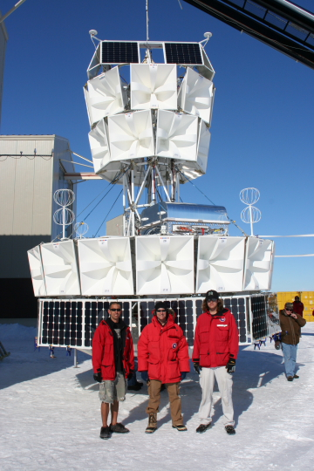
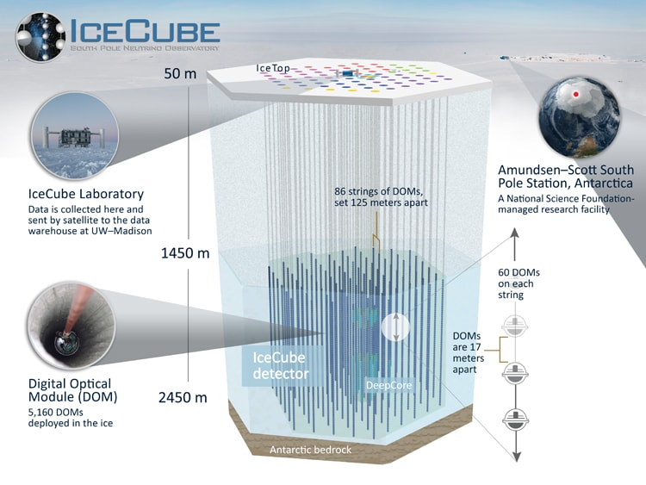
IceCube source: https://icecube.wisc.edu/science/icecube/ ANITA source: https://www.phys.hawaii.edu/~anita/campaigns/anita-ii

Slide 5
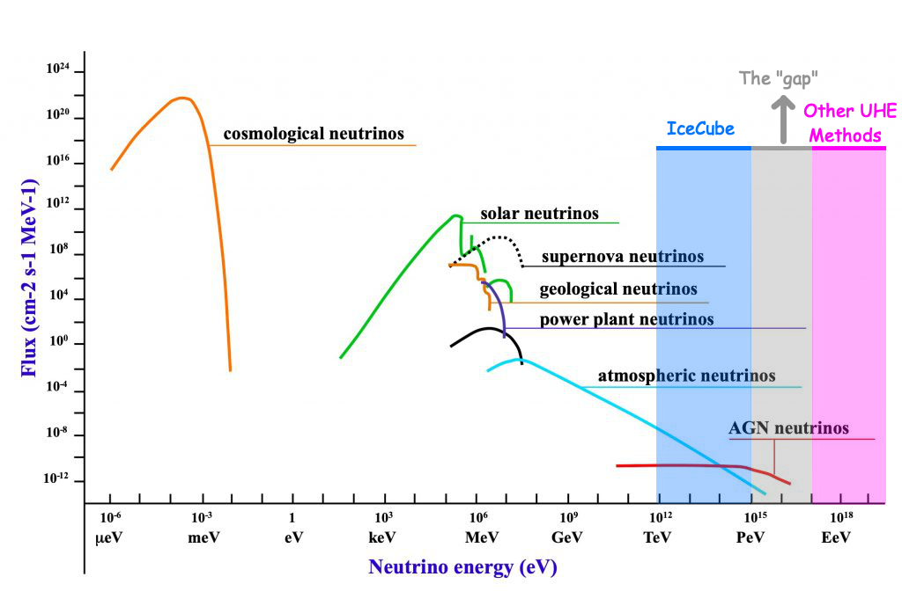
Notes:
As a quick review, in the energy spectrum of neutrinos, there exists a gap in our current capabilities to effectively detect Ultra High Energy neutrinos. The active radar sounding method offers a chance to peel back the curtain and illuminate this energy range.

Slide 6
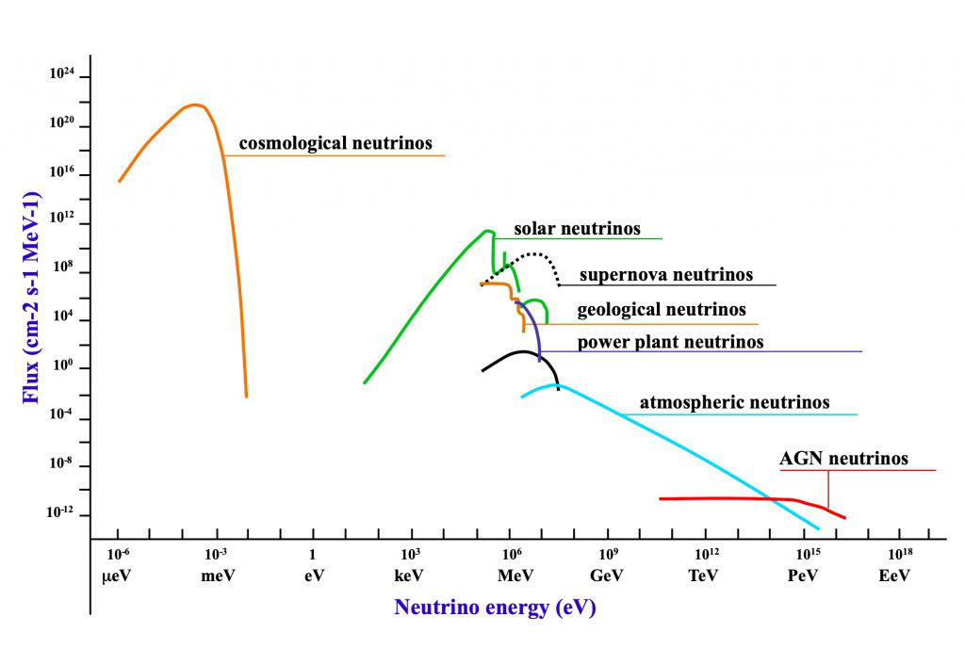
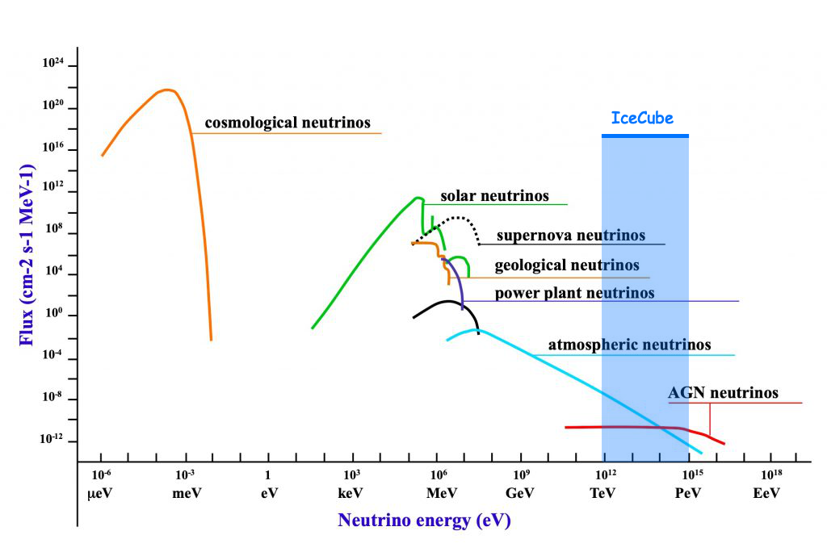
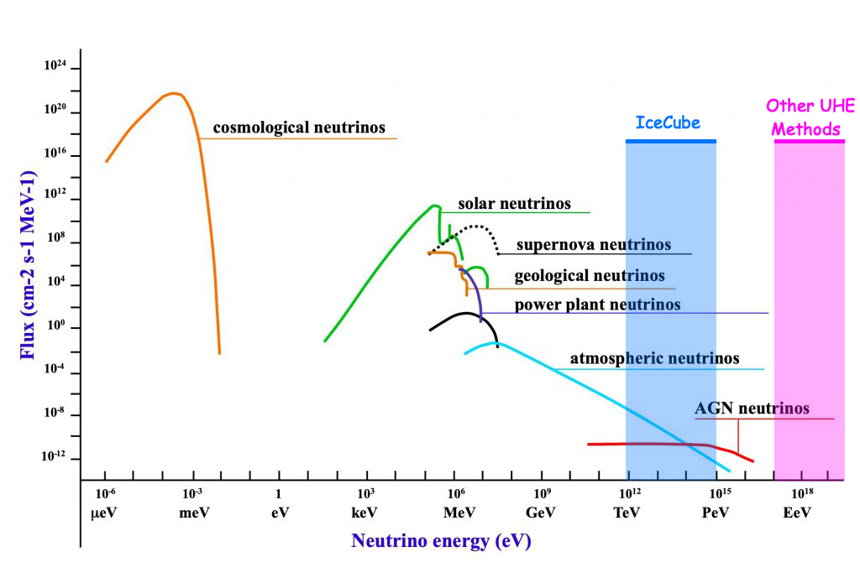
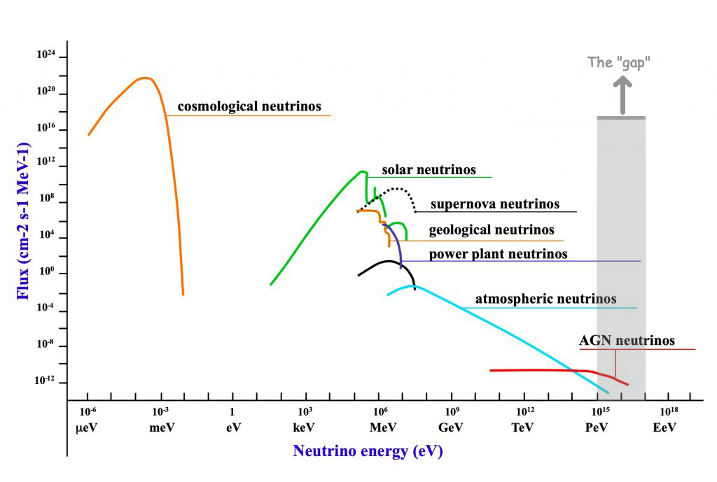
Notes:
UHE ≥ 10¹⁶ eV
Limiting factor of IceCube on the high end is flux or number of neutrinos per cubic unit of area. The energy is great enough that Icecube can see it but only if the neutrino hits the bullseye that is the detector.

Slide 7
Notes:
UHE ≥ 10¹⁶ eV

Slide 8

The case for active radar emission based neutrino detection methods
“Sir, you were going 6.706e8 in a 35”
Notes:
How do we detect these ultra high speed particles? We almost need to set up a speed trap

Slide 9
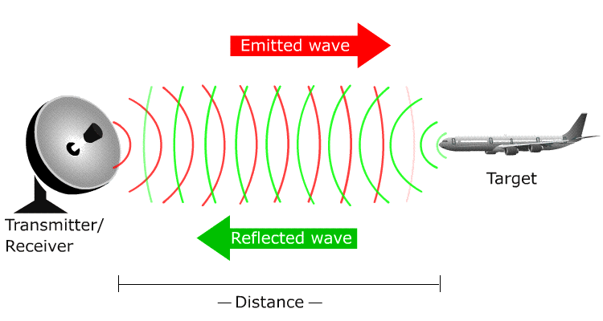
RADAR - RAdio Detection And Ranging
Requirements: Transmitter, target, and receiver

Slide 10
Neutrino Particle Shower Plasma
“As these shower particles traverse the interaction medium, they eject cold ionization electrons from atoms in the bulk, forming a tenuous particle-shower plasma (PSP), distinct from the energetic shower front particles responsible for ionization. For high incident particle energies (E ≥ 1 PeV, consistent with, and beyond, the experimental reach of the IceCube[1] experiment), this plasma will become dense enough to reflect incident radio-frequency (RF) radiation”
Notes:
This is the cardinal sin of powerpoint and I apologize. I leave it here in case anyone wants to read the full thing.
Greater than 1 PeV? Where have we seen that before?

Slide 11
Notes:
At PeV and higher energies, the plasma becomes dense

Slide 12
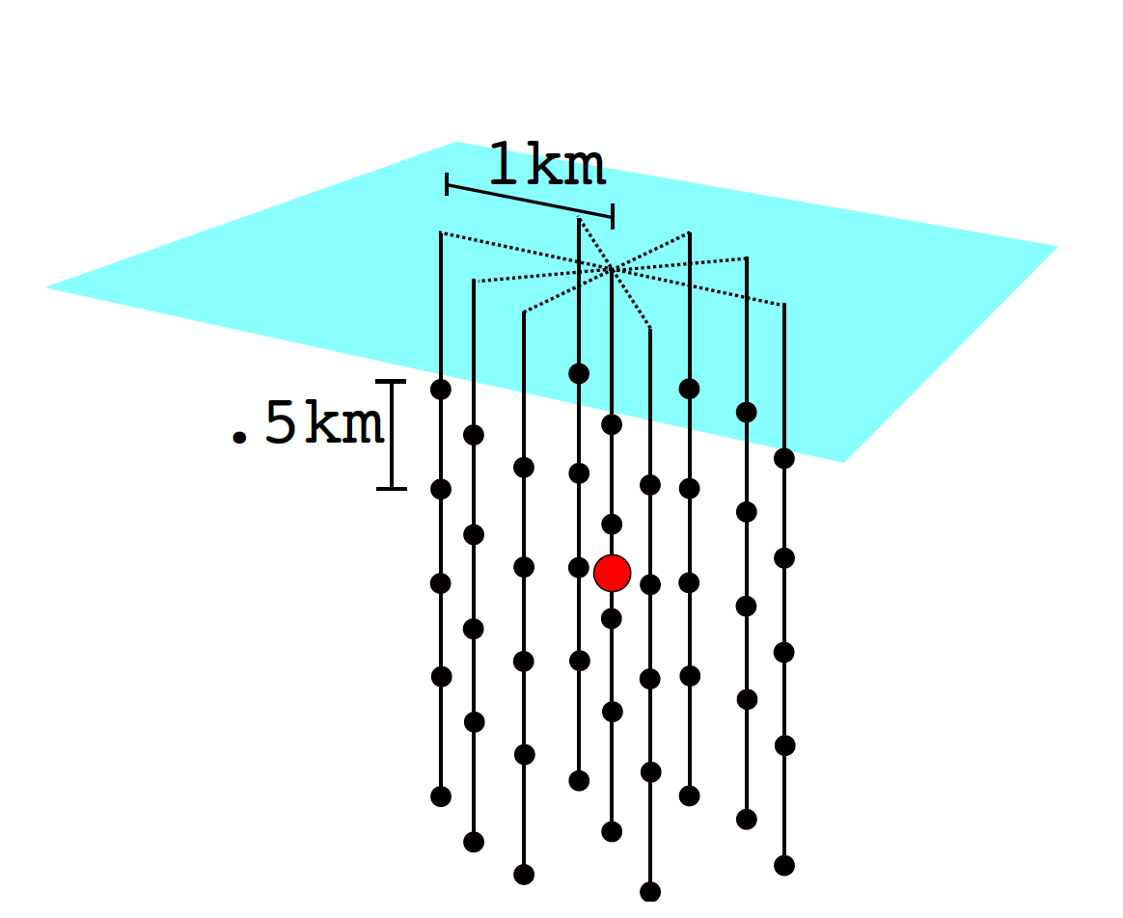
Example detector
Observation of Radar Echoes From High-Energy Particle Cascades
S. Prohira, K.D. de Vries, P. Allison, J. Beatty, D. Besson, A. Connolly, N. van Eijndhoven, C. Hast, C.-Y Kuo, U.A. Latif, T. Meures, J. Nam, A. Nozdrina, J.P. Ralston, Z. Riesen, C. Sbrocco, J. Torres, S. Wissel: 2019
https://arxiv.org/abs/1910.12830

Slide 13
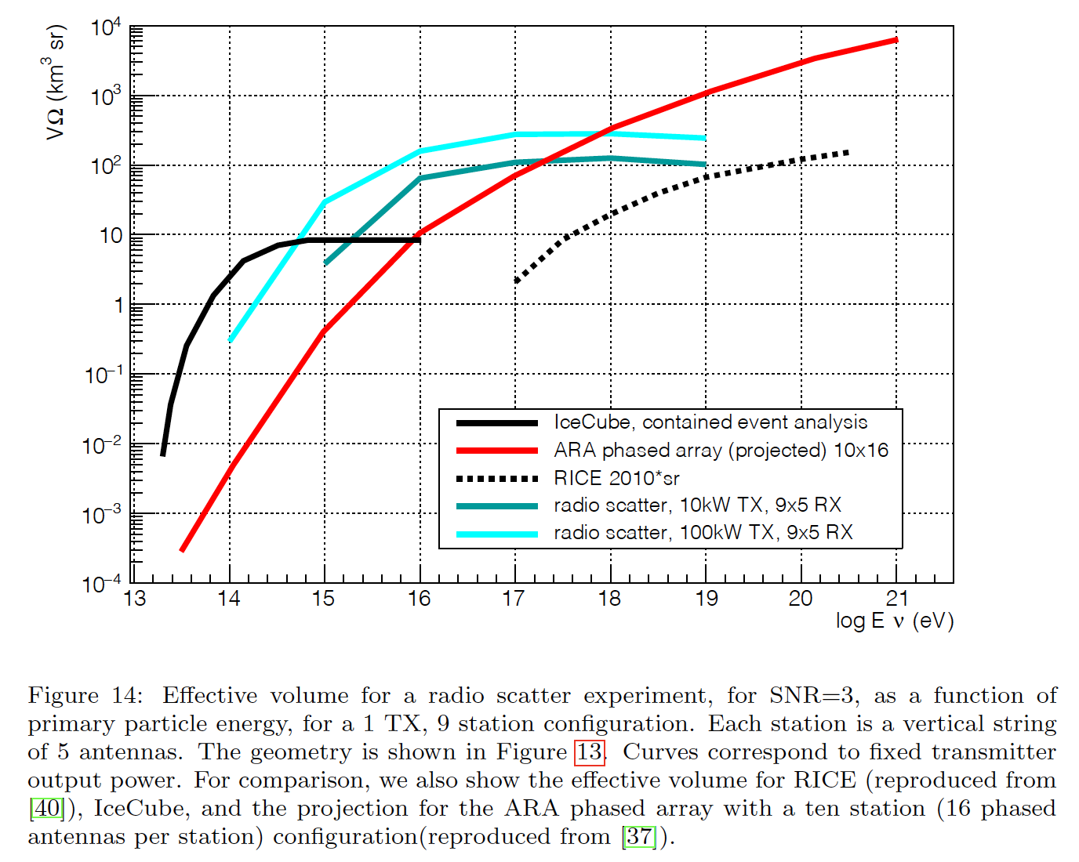
Effective array volume
Observation of Radar Echoes From High-Energy Particle Cascades
S. Prohira, K.D. de Vries, P. Allison, J. Beatty, D. Besson, A. Connolly, N. van Eijndhoven, C. Hast, C.-Y Kuo, U.A. Latif, T. Meures, J. Nam, A. Nozdrina, J.P. Ralston, Z. Riesen, C. Sbrocco, J. Torres, S. Wissel: 2019
https://arxiv.org/abs/1910.12830

Slide 14
Advantages of active emission
Received signal strength scales with transmitter signal power, not just particle energy
Indirect particle detection
The “plane” doesn’t have to hit the reciever for the reciever to see it
Greater detection range = lower sensor density = larger array
Better anthropogenic and background noise rejection
Received signal should closely match transmitted signal
Continuous CW pulse – from transmitter in shadow zone
Active detection sensitivity should peak in the 10-100PeV range where other sensors are less effective
Notes:
The nice thing about radar is that the reflected signal you get back should be roughly the same as what you transmitted, it is the transformations to that signal that give you information about what they were reflected off of.

Slide 15

Radio Scatter
C++ over ROOT radio/particle simulation software
Used to simulate incident radio frequency Radiation from a particle shower and scattered signal
i.e. simulates shooting high speed plasma with a radar gun
Calculates with regard to and allows testing of:
Transmitter, particle, & reciever geometries
Antenna gain
Refraction properties in the medium (ice)

Slide 16
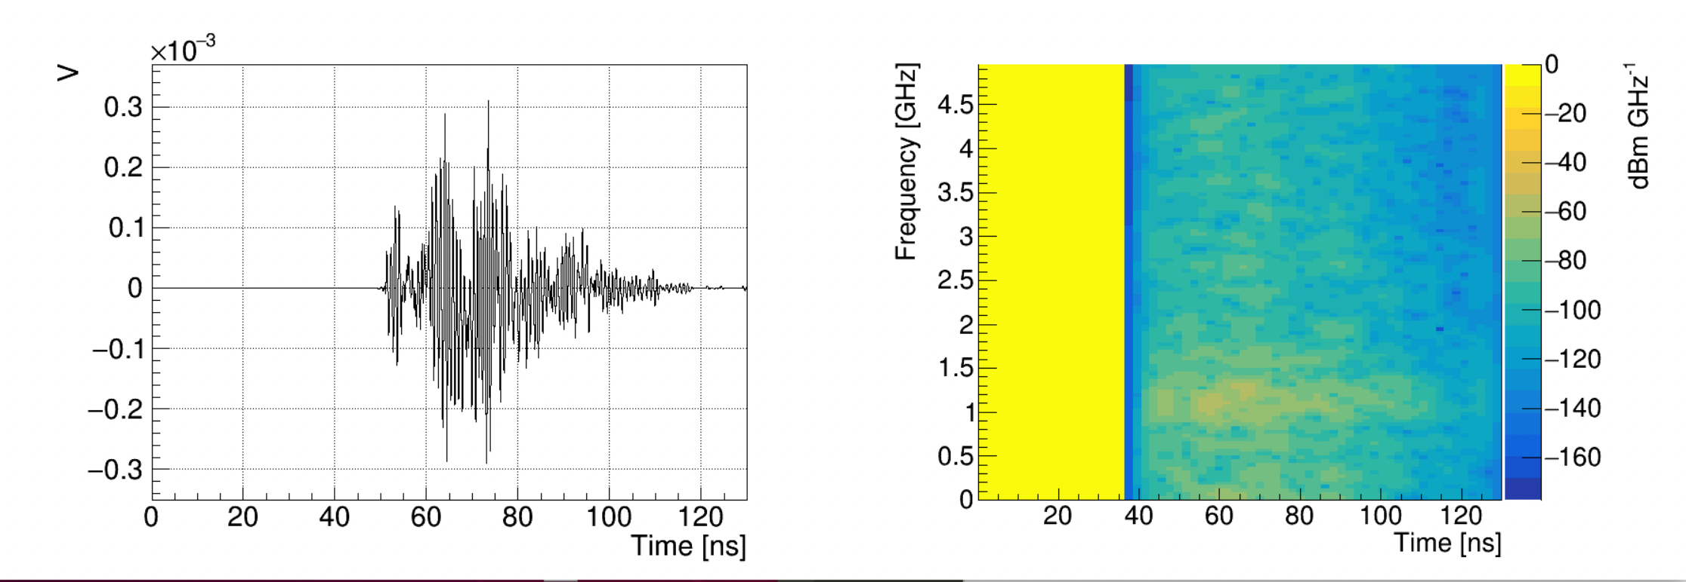
Early results
Notes:
On the left we see a clean, noiseless waveform reflected off of the digital plasma from the shower shower. On the right is a spectrogram which shows a wide swath. Oddly the swath starts at about 37 nanoseconds while the waveform pulse begins around 50ns from t-zero

Slide 17
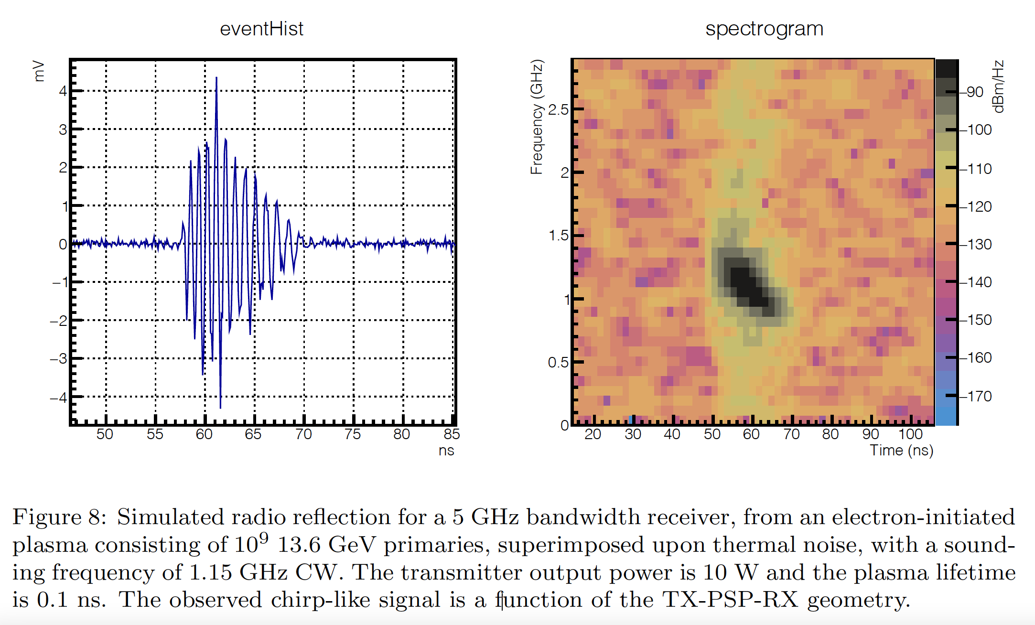
The ideal return
Particle-level model for radar based detection of high-energy neutrino cascades
S Prohira, D Besson: 2017
https://arxiv.org/abs/1710.02883
Notes:
In the radio talk a week ago I asked if this was even a useful way to plot the data. This is a prettied up plot of a better return. Notice that the waveform shows noise but the received signal rises out of it nicely. In the spectrogram, the chirp shows up relatively narrow and discrete from the surrounding background. The spectrogram plotting frequency, time, and intensity against one another is very useful for rapid qualitative recognition. This is how passive sonar data is interpreted in a time frequency LOFAR display (Low Frequency Analysis and Ranging). Why is it black though? i.e. low intensity?
Sidebar: if anyone wants me to talk offline (or in here) about why the rays trace like they do and why some of this stuff works I can do that. I say that only because a few people have asked or gotten me on that tangent and said “oh that makes sense now.”

Slide 18
The path forward
Testing different geometries and power levels
Optimize settings for discreet chirps vice broadband swaths
Determine effective and efficient geometries
Build it!
The University of Kansas will build a test pinger for the Radio Echo Telescope (RET) group

Slide 19
Info, data, chart sources
Particle-level model for radar based detection of high-energy neutrino cascades
S Prohira, D Besson: 2017
https://arxiv.org/abs/1710.02883
Observation of Radar Echoes From High-Energy Particle Cascades
S. Prohira, K.D. de Vries, P. Allison, J. Beatty, D. Besson, A. Connolly, N. van Eijndhoven, C. Hast, C.-Y Kuo, U.A. Latif, T. Meures, J. Nam, A. Nozdrina, J.P. Ralston, Z. Riesen, C. Sbrocco, J. Torres, S. Wissel: 2019
https://arxiv.org/abs/1910.12830

Slide 20
Questions?

